Slide 1
Kai Hwang Cloud Computing for Machine Learning and Cognitive Applications The MIT Press, Cambridge, MA, 2017 Chapter 1: Cloud Computing Principles and Technologies (52 slides for 3-hour lectures) In total, there are 746 slides in 10 chapter files. These slides are suggested for use in 45 hours of lectures for senior undergraduate or graduate courses in one semester. All rights reserved by Kai Hwang, September 2017. These are offered through MIT Press for exclusive use by qualified instructors adopting the textbook. All slide files are not for public sale, publication, or release.

Slide 2
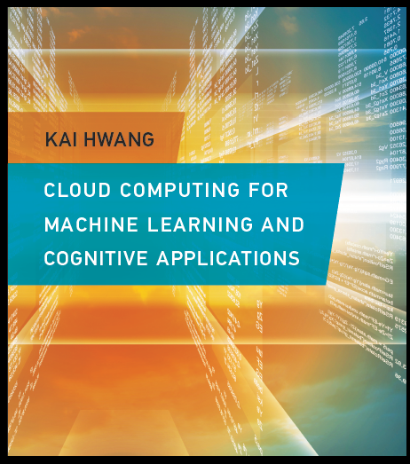
Published by The MIT Press, Cambridge, MA, on June 16, 2017. 601 pages.
Library of Congress ISBN 978-0-262-03641-2.
Available at the USC Bookstore, The MIT Press (mitpress.mit.edu), and Amazon (www.amazon.com).

Slide 3
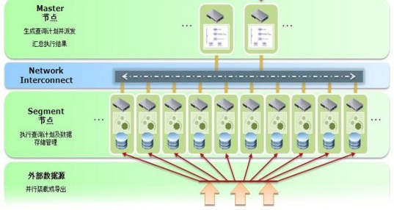
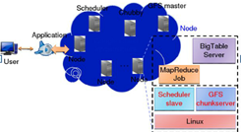
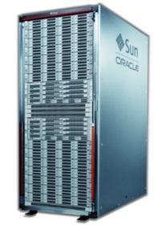

Cloud computing over big data
Structured data; low processing efficiency of unstructured data
Expensive hardware; Poor compatibility
High scalability with Vendor lock-in of data resources
Structured data; low prosing efficiency of unstructured data
Expensive cessing efficiency of unstructured data
Expensive hardware; Poor compatibility
High scalability with Vendor lock-in of data resources
Hybrid analysis capabilities of structured/unstructured data
X86 servers; good compatibility
High scalability, over 10,000 node-level deployment
Traditional Database/ Data Warehouse
Supercluster (Data Warehouse) + Hadoop + Spark + Storm + TensorFlow + …..)
TB
PB
Distributed architecture
EB 🡪 ZB
Notes:
基于云计算的大数据发展

Slide 4
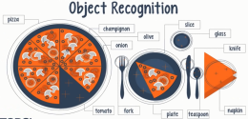
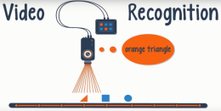
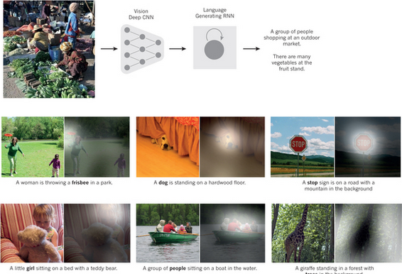

Machine learning and cognitive applications
(a) Object recognition (b) Video recognition
(c) Image retrieval (d) Fact extraction
4
Notes:
4

Slide 5

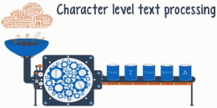


Machine and deep learning applications Classified in 16 Categories (continued)
(e) Machine translation (f) Text processing
(g) Speech recognition (h) Natural language processing
5
Notes:
5

Slide 6

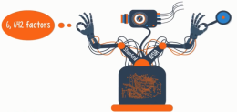
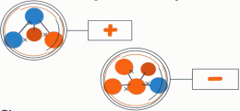
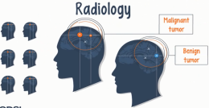
Machine and deep learning applications Classified in 16 Categories (continued)
(i) Sentiment analysis
(j) Cancer detection
(k) Drug discovery/toxicology
(l) Radiology
Notes:
6

Slide 7
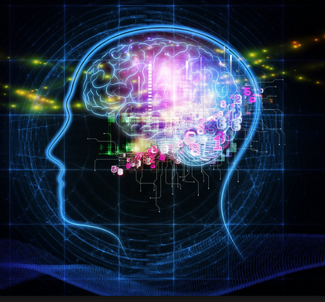
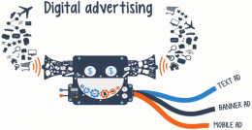
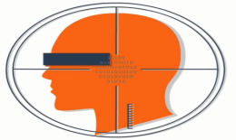
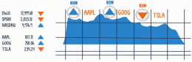
Machine and deep learning applications Classified in 16 Categories (continued)
(m) Bioinformatics (n) Digital advertising
(o) Fraud detection (p) Sell and buy prediction
7
Notes:
7

Slide 8
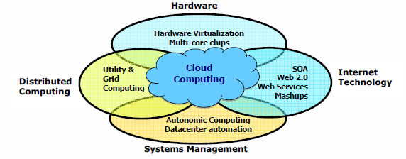
Data deluge enabling new challenges

Slide 9
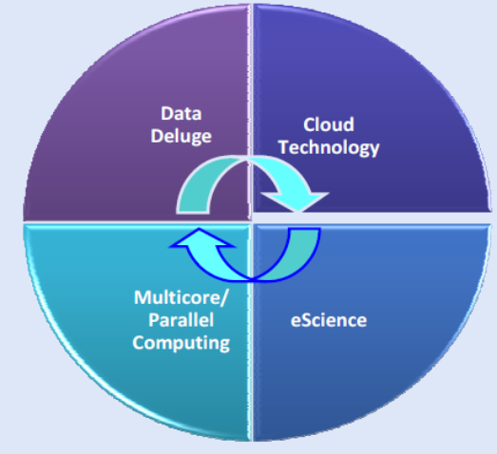
Interactions among 4 technical challenges: Data deluge, cloud technology, eScience, and multicore/parallel computing
You have to attend all lectures, read books and some selected papers, do the homework, perform the cloud experiments, write the project report, and do well in quizzes, and mid-term and final exams.
Do not take this course if do not have the time to dedicate yourself to it.

Slide 10
From desktop/HPC/grids to datacenters and clouds in 30 years
HPC moving from centralized supercomputers to geographically distributed desktops, desksides, clusters, and grids, to clouds over last 30 years
R/D efforts on HPC, clusters, Grids, P2P, and virtual machines have laid the foundation of cloud computing and have been greatly advocated since 2007
Location of computing infrastructure in areas with lower costs in hardware, software, datasets, space, and power requirements – moving from desktop computing to datacenter-based clouds

Slide 11
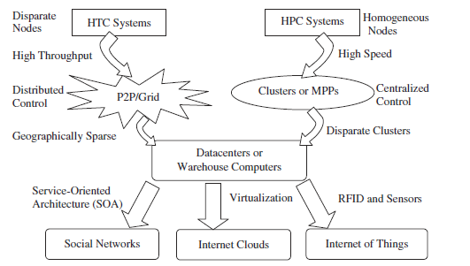
From HPC Systems and Clusters to Grids, P2P Networks, Clouds, and the Internet of Things
HPC: High-Performance Computing
HTC: High-Throughput Computing
P2P: Peer-to-Peer
MPP: Massively Parallel Processors

Slide 12
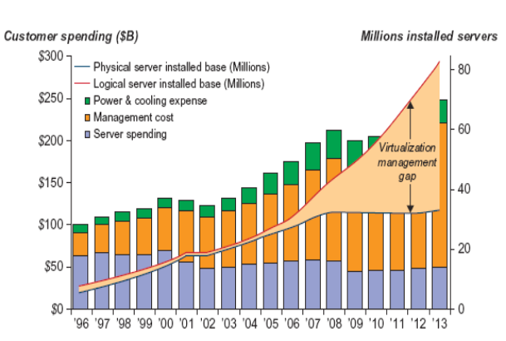

Slide 13
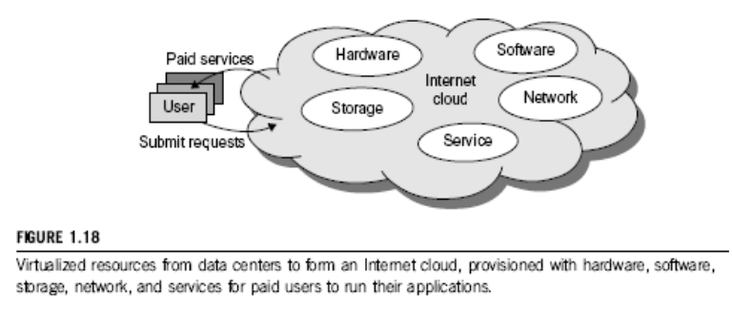
Basic concept of Internet clouds

Slide 14
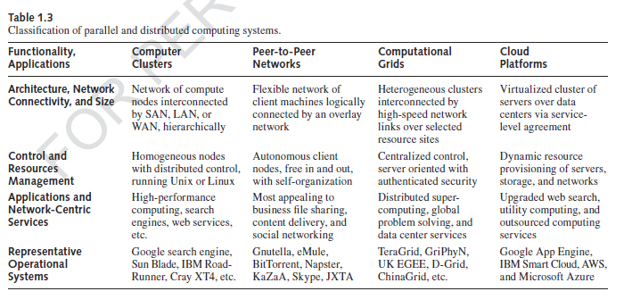
From clusters, P2P networks, and grids, to clouds

Slide 15
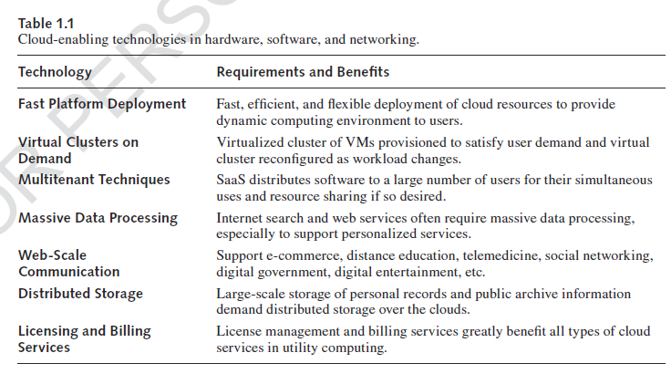
Enabling technologies for clouds

Slide 16
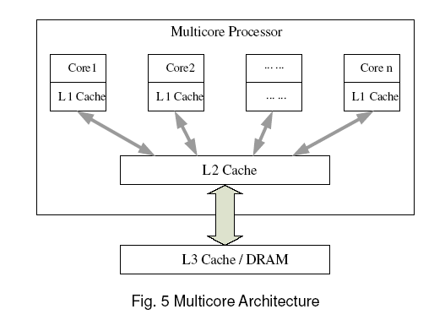
A typical multi-core processor

Slide 17
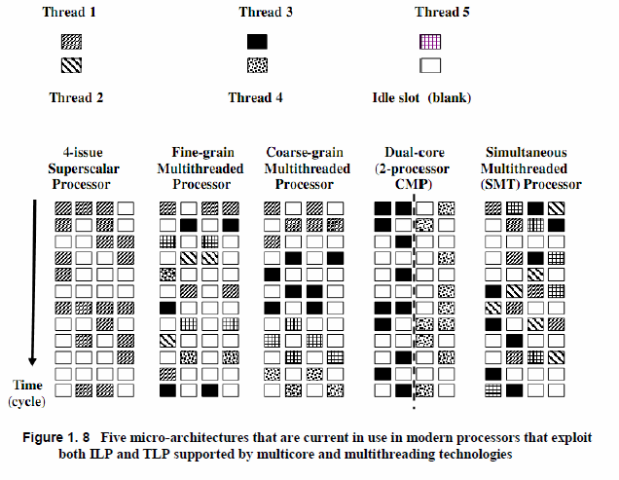
Multi-core and multithreaded processors

Slide 18
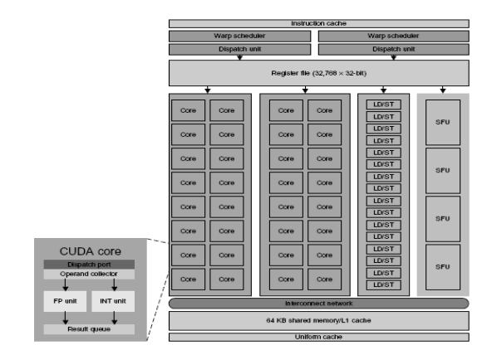
Many-core GPU layout by Nvidia

Slide 19
Intel building the eco-system of AI or DL chips
Environment | Brief Description
User-end | Human-machine interaction (Intel® Edison platform, Intel® Cedar Trail platform, Intel® RealSense™ technology)
Server-end | Xeon E5 v4 series CPU; Xeon Phi™ Product Family
Software Service | Intel® Math Kernel Library(Intel® MKL); Intel® Data Analytics Acceleration Library (Intel® DAAL)
Extending Performance | Purchased Altera Corporation; Integrated chip featuring Xeon core and FPGA
Business Acquisition | Purchased high-tech companies: Nervana, Movidius, Itseez, etc.

Slide 20
Nvidia GPUs for machine learning use
GPU Chip Model | Targeted applications in datacenters or cloud computing arena
Tesla P100 | Deep learning training accelerator for the data center
Tesla P40/P4 | Energy-efficient inference accelerator for deep learning
Jstson TKI1TX1 | The embedded AI supercomputer for intelligent devices.
Drive PX2 | Scalable in-vehicle AI supercomputer for autonomous driving

Slide 21
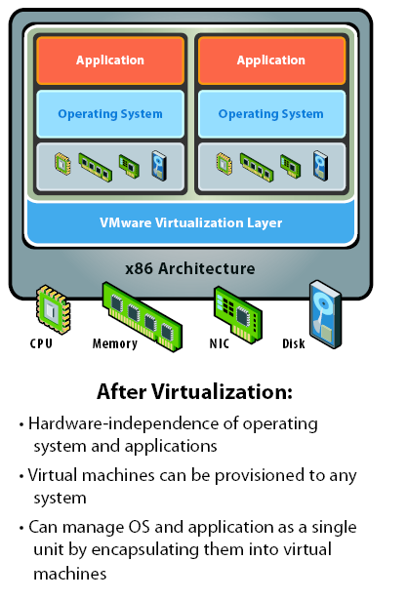
Virtual computer architecture

Slide 22
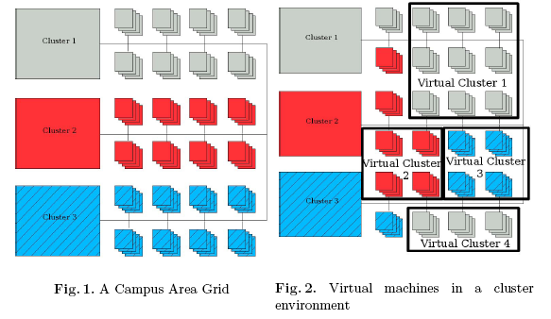
Concept of virtual clusters

Slide 23
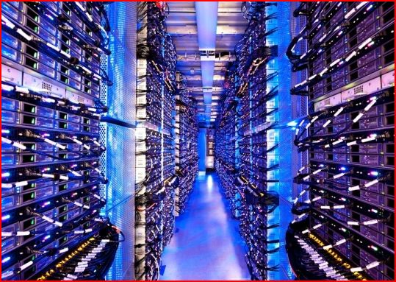

The cloud
Historical roots in today’s Internet applications
Search, email, social networks
File storage (Live Mesh, Mobile Me, Flicker, etc.)
A cloud infrastructure provides a framework to manage scalable, reliable, on-demand access to applications
A cloud is the “invisible” backend to many of our mobile applications
A model of computation and data storage based on “pay as you go” access to “unlimited” remote data center capabilities

Slide 24
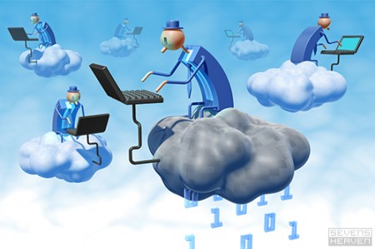
The next revolution in IT Cloud computing
Classical computing
Buy & own
Hardware, system software, applications often to meet peak needs.
Install, configure, test, verify, evaluate
Manage
..
Finally, use it
$$$$....$(High CapEx)
Cloud computing
Subscribe
Use
$ - pay for what you use, based on QoS
Every 18 months?
(Courtesy of Raj Buyya, 2012)

Slide 25
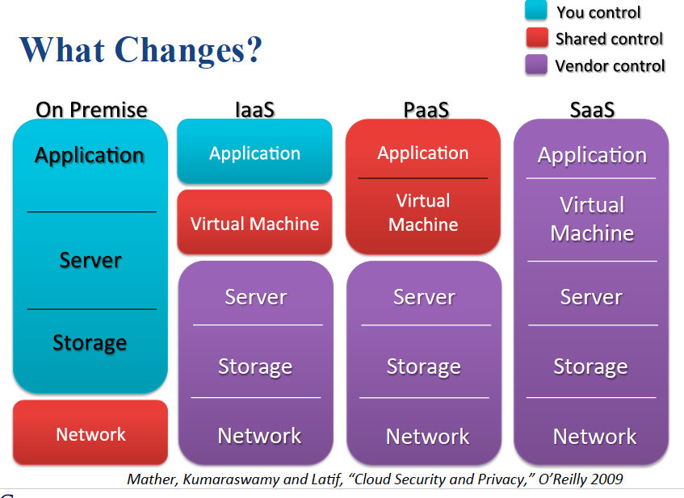

Slide 26
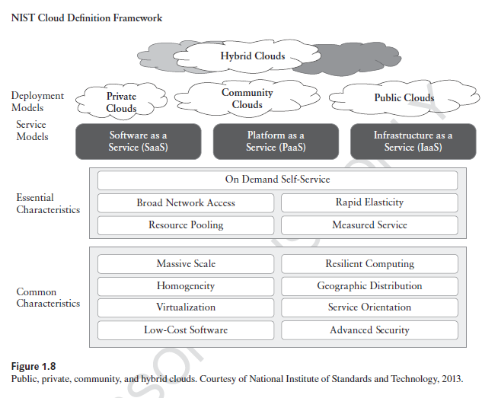
Lecture 2: Cloud architecture and service models, Aug. 23, 2017

Slide 27
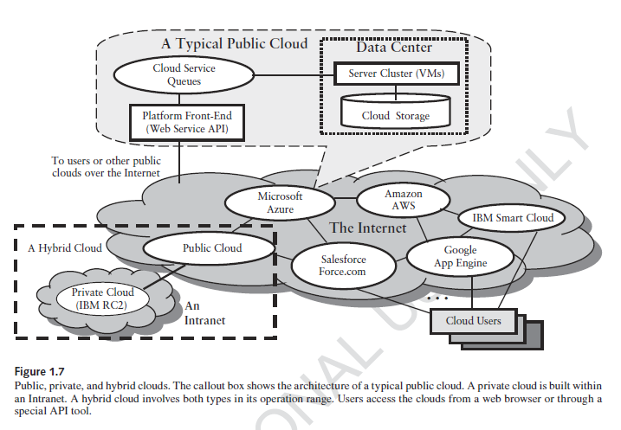

Slide 28
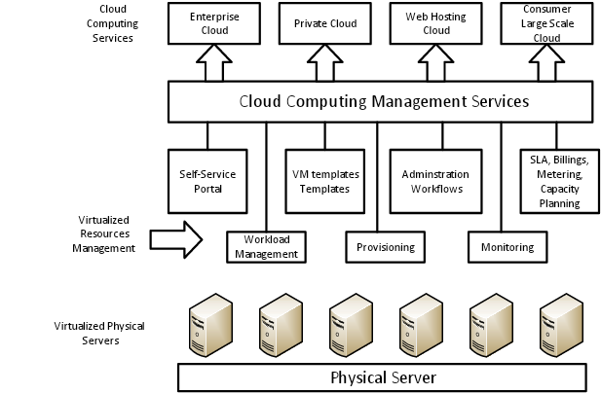

Slide 29
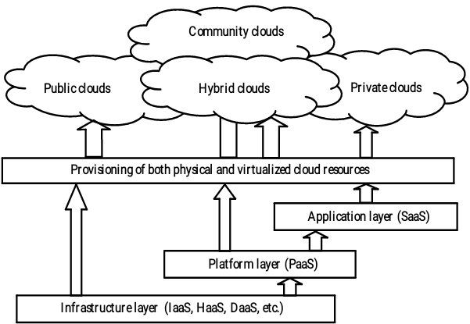

Slide 30
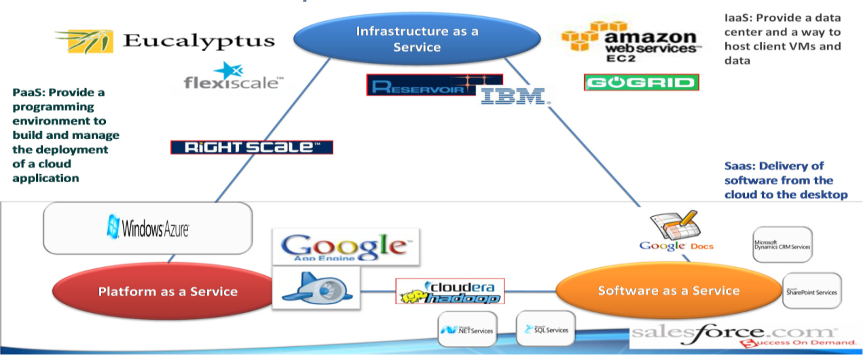
Notes:
30

Slide 31
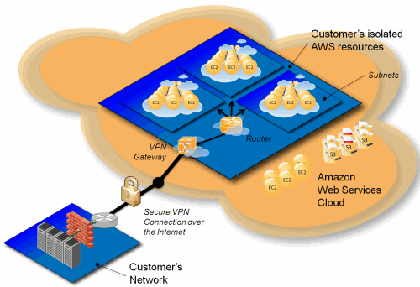

Slide 32
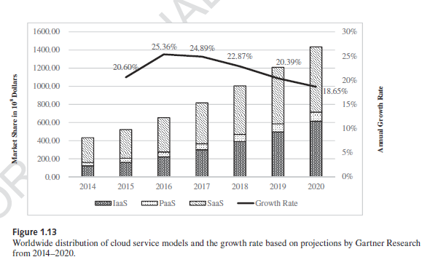
Market share of various cloud platforms

Slide 33
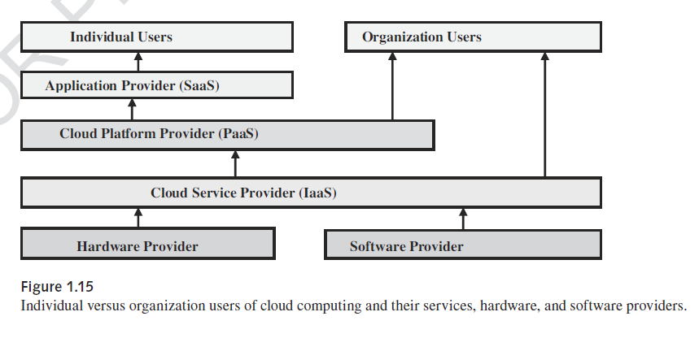
Cloud users vs. cloud providers
Notes:
33

Slide 34
Table 1.4. Cloud providers and vendors
Cloud Players | IaaS | PaaS | SaaS
IT adminis-trators and cloud providers | Monitor SLAs | Monitor SLAs and enable Service Platforms | Monitor SLAs and deploy software
Software developers (vendors) | To deploy and store data | Enabling Platforms via configurator and APIs | Develop and Deploy Software

Slide 35
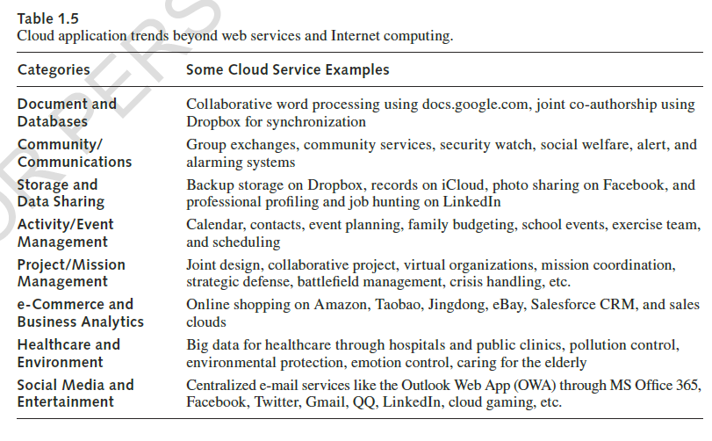

Slide 36
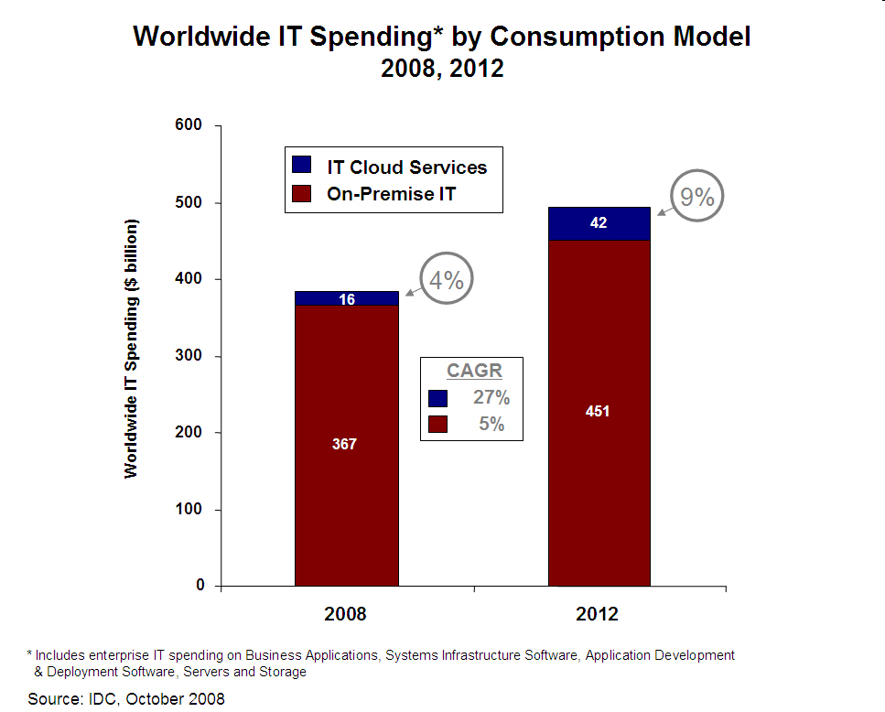
Cloud business potential: A trillion-dollar-business/year by 2020?
2000
600?
30%
120?
15%
2016
2020?

Slide 37
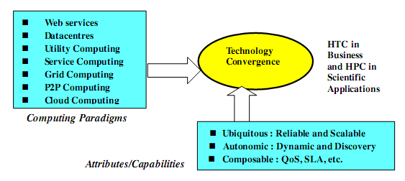
Technology convergence toward HPC for science and HTC for business

Slide 38
Warehouse-scale computer
Provides Internet services
Search, social networking, online maps, video sharing, online shopping, email, cloud computing, etc.
Differences with HPC “clusters:”
Clusters have higher performance processors and network
Clusters emphasize thread-level parallelism, WSCs emphasize request-level parallelism
Differences with datacenters:
Datacenters consolidate different machines and software into one location
Datacenters emphasize virtual machines and hardware heterogeneity in order to serve varied customers
Notes:
The University of Adelaide, School of Computer Science
1 March 2022
Chapter 2 — Instructions: Language of the Computer
38

Slide 39
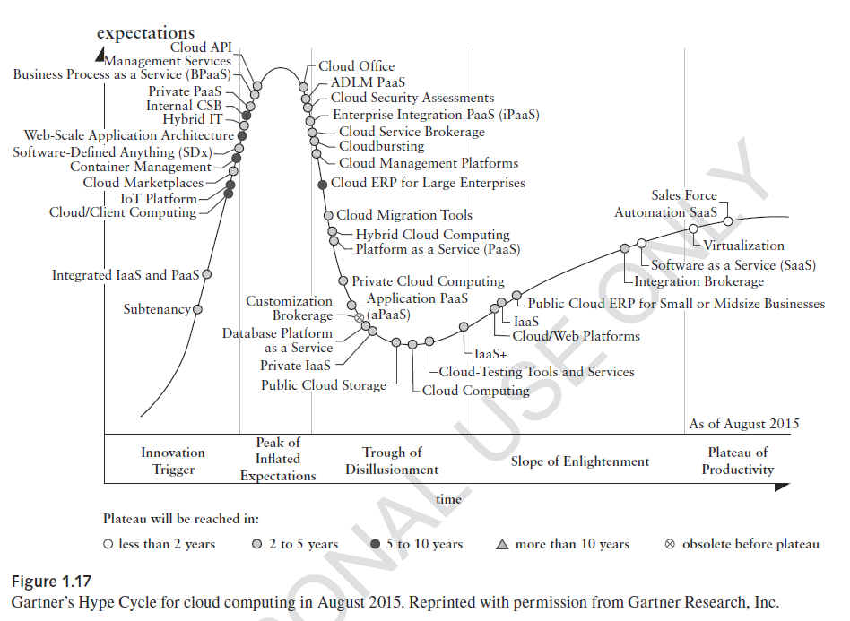
2015 cloud technologies

Slide 40
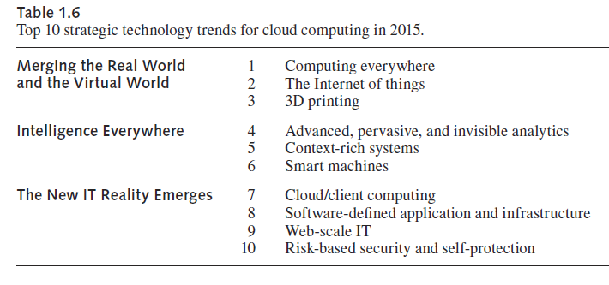

Slide 41
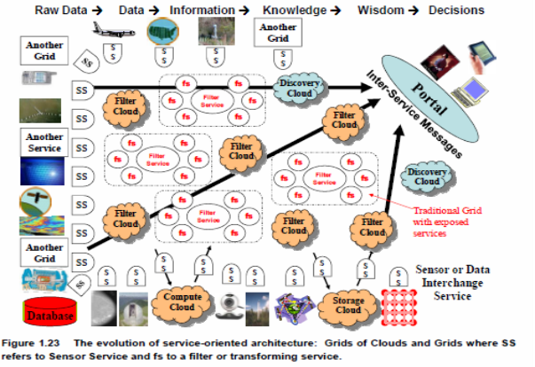
Services-Oriented Architecture (SOA)

Slide 42
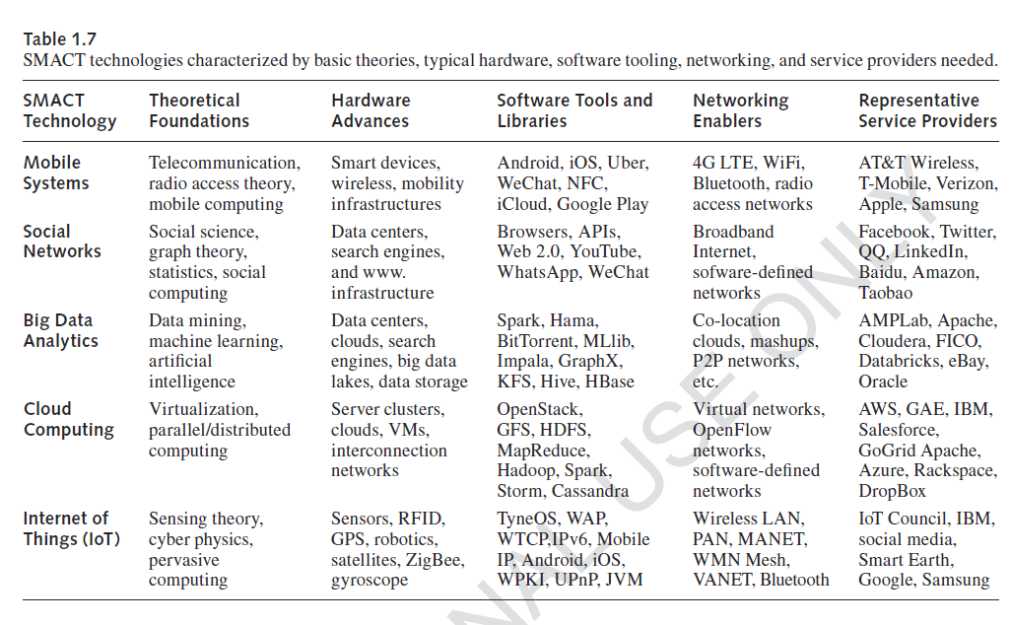
Integrated SMACT technologies
Notes:
42

Slide 43
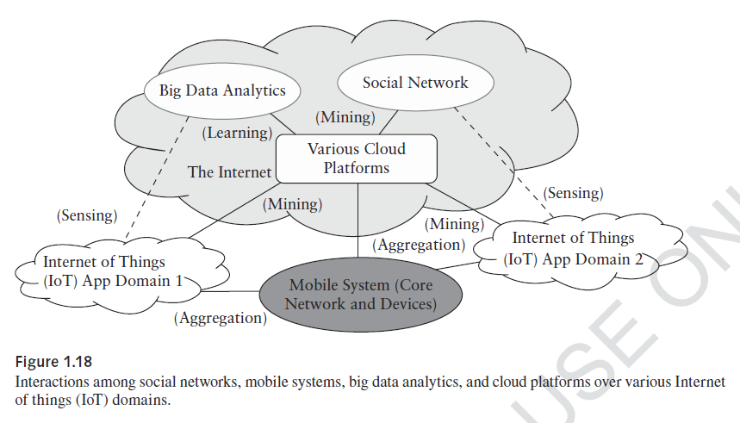
Notes:
43

Slide 44
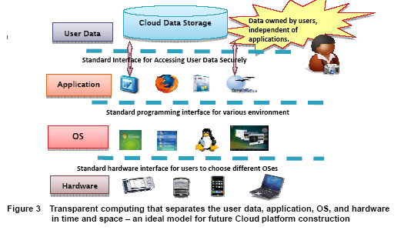
Transparent cloud computing environment

Slide 45
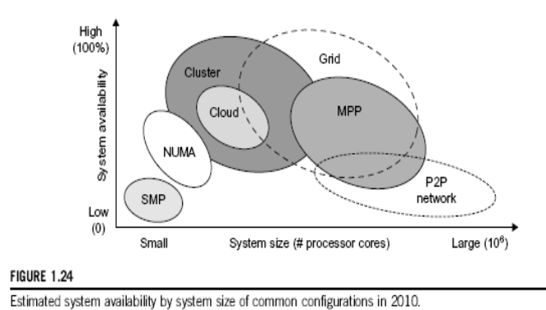
System availability vs. configuration size
Notes:
45

Slide 46
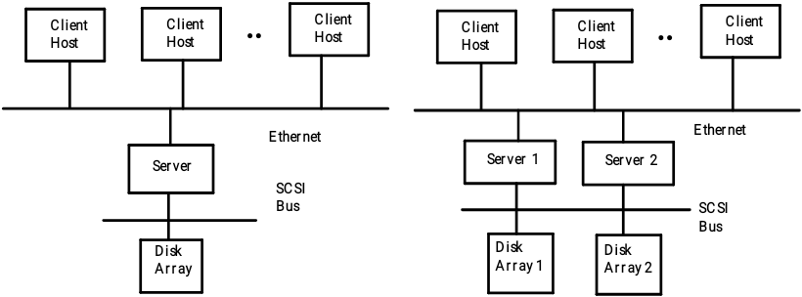
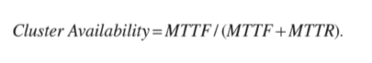
Single point of failure: The server and the disk

Slide 47



Slide 48


Slide 49


System availability analysis

Slide 50


Multiserver cloud service model
The operation of an m-server cluster can be modeled by an M/M/m queueing system,
where λ is service task arrival rate and μ is the average service rate of task requests. In what follows, we derive the formulas to estimate the average task response time. The parameter ρ = λ /mμ is the probability of having requests in the queue.

Slide 51

Multiserver cluster optimization
C is the expected charge to s service request, which is a very complex function of many parameters.
is the expected business gain (i,e. net profit) of a service provider.
The following is profit gain function to be optimized with respect to the cluster size (m) and the server speed (s).

Slide 52
Concluding remarks
Big data and clouds demand a major overhaul of our educational programs in science and technology
We must use clouds and big data analytics in storing, processing, and mining of big data, which changes rapidly in time and space
Machine intelligence, clouds, IoT, and social networks are being integrated together to promote global economy, public healthcare, smart cities and environments
On the negative side, 30% of jobs will be replaced by smart machines, autonomous vehicles, etc. Data privacy and cyber-space crimes will grow.

